Slide 1

Optimizing RIDE Sharing allocation
Analysis on Ridership for Transportation Network Providers(TNP) In Chicago
Presented by:
Amily huang, Duo Zhou and Yiheng Zhu

Slide 2




MEET THE TEAM
Duo Zhou
Amily Huang
Yiheng Zhu
zd0009@uchicago.edu
yunh@uchicago.edu
yihengzhu@uchicago.edu

Slide 3
content
Executive Summary
Data Ingestion & Preparation
Data Modeling & Design
Analytics & Results
Future Work
Conclusion & Recommendations

Slide 4
EXECUTIVE SUMMARY

Slide 5
Executive Summary
Our goal is to optimize vehicle allocation according to ridership demand and give business insights and recommendations to TNP
Use weather, sport events, crime, and census data to analyze customer behavior and to give precise recommendations
We focused on relational database system which can efficiently load, store, and extract data from different sources for analysis (OLAP)
Notes:
which is essential to the success of Transportation Network Providers (TNP) (Rideshare Companies)
Ridership demand can be greatly affected by, and many other factors.

Slide 6
Business Use Case
Actor | Incentive | Business Use
TNP | To better understand customer behavior Vehicle allocation Optimization Improve customer service management | Understand how different factors impact ridership and customer behavior
Driver | Maximize income per unit time | Understand how tips vary in different circumstances
Customer | Time-efficient and safer service | Improvement of service experience with better vehicle allocation and customer service

Slide 7
Data ingestion & Preparation

Slide 8





Solution overview: Data / Tools
Main dataset:
Data Processing/
Storage:
Visualizations:
Transportation Network Providers
- Trips by Location, Distance, Day/Time, Tips, etc.
Python
- matplotlib
- seaborn
- ggplot
Tableau
Python
- Data Cleaning and Processing
MySQL(GCP)
- Data storage and model design
Excel
- Data Cleaning and Processing
UChicago RCC
- Cloud Computing for Large Datasets
Supporting dataset:
Data Connectors:
Weather
- Historical Weather Conditions, Short-term Forecasts
City of Chicago Data Portal
- CSV batch download
ESPN
- Python web scraping
NoAA
- API
Geography
- Community area boundaries in Chicago
Analytics:
Sports Event
- Chicago sports team (NBA,NFL,MLB) schedules
Python
- sklearn
- fbprophet
- pandas
- scipy
- numpy
Census & Crime
- Income, Education, Crime Rate by Chicago Community Area (CCA)

Slide 9
DATA PREPARATION
Data Source | Format and Size | Processed Data That Meet Analytical Needs | Platform and Tools Used
Chicago Data Portal: Transportation Network Providers | 30 GB (129 Million Rows, 21 Columns) Structured CSV File | Ridership, Avg Traveled Distance, Avg Tips and Number of Pooled trips Group by CCA, Date and Time | Python, MySQL GCP and RCC
Chicago Data Portal: Boundaries - Chicago Community Area (CCA) | 1.92 MB Structured CSV File | MULTIPOLYGON Data by CCA For Tableau | Python and Excel
Census Data By CCA | 1.1 MB Structured CSV File | Education, Age, Income, Population & Unemployment Rate etc. by CCA | Python, MySQL
Chicago Data Portal: Crimes | 16 GB (7.12 Million Rows, 22 Columns) Structured CSV File | Total Number of Crimes By CCA | Python, MySQL GCP and RCC
ESPN | 2 MB Unstructured Data: From Web Scraping | Only the home game dates and location | Python and Excel
National Centers for Environmental Information | 5.5 MB Structured CSV File | Avg daily temp, total daily precipitation and avg daily wind speed by date. | Python and Excel
Wikipedia: Community Areas in Chicago | 0.1 MB Unstructured Data: From Web Scraping | Chicago community area code | Python and Excel

Slide 10
Data MODELING & DESIGN

Slide 11
DATA MODELING
Compiling Data into Tables
Use MySQL Workbench to create our dimensional tables
Sports and Weather tables are indexed by Date (primary key)
Census and Crime tables are indexed by Chicago Community Areas(CCA) (primary key)
Date and CCA are both linked to the fact table as foreign key
Data Transformations
Data are transformed into a rows and columns format with appropriate data type
Main dataset ridership measures are aggregated and grouped by CCA, date and time
Sports schedule datasets, and weather datasets are aggregated and grouped by date
Census and Crime datasets are aggregated and grouped by CCA
CCA Geographic boundaries data are transformed to meet tableau virtualization requirement
Data Mapping
One main dataset (fact table with ridership measures) and four supporting datasets (dim tables)
Star type dimensional model is adapted by linking 4 dimensional datasets to the main fact dataset using either DATE or CCA
Note: Ridership By Hours of A Day is an independent analytical entity that provides additional business insights on ridership, tip and Shared Trips
Notes:
We use MySQL Workbench to create our dimensional table. Sports and weather tables are indexed by Date (primary key), Census and Crime tables are indexed by Chicago Community Areas(CCA) (primary key). Date and CCA are both linked to the fact table as foreign key.
All data are transformed into a rows and columns format with appropriate data type.
Main dataset ridership measures are aggregated and grouped by CCA, date and time.
Sports schedule datasets, and weather datasets are aggregated and grouped by date.
Census and Crime datasets are aggregated and grouped by CCA.
CCA Geographic boundaries data are transformed to meet tableau virtualization requirement
We have one main dataset (fact table with ridership measures) and four supporting datasets (dim tables). A star type dimensional model is adapted by linking 4 dimensional datasets to the main fact dataset using either DATE or CCA.
Note: Ridership By Hours of A Day is an independent analytical entity that provides additional business insights on ridership, tip and Shared Trips.

Slide 12
DESIGN CONSIDERATIONS
Data Types
- id: INT
- Date: DATE
- CCA: INT
- MEAN & MEDIAN attributes: DOUBLE
- Others: INT
Dealing with NAs
Weather:
- Drop NA rows
Main Dataset:
- Fill NA with 0
Using Dimensional Tables
- Maintain historical information for all dimensions
Expected Output of Data Analysis (Data Quality Metrics)
- The relationship between census attributes and fact measures
- The impact on fact measures from different weather factors
- The impact on fact measures during major sports event
- The relationship between public safety and fact measures
- Less processing time and higher performance

Slide 13
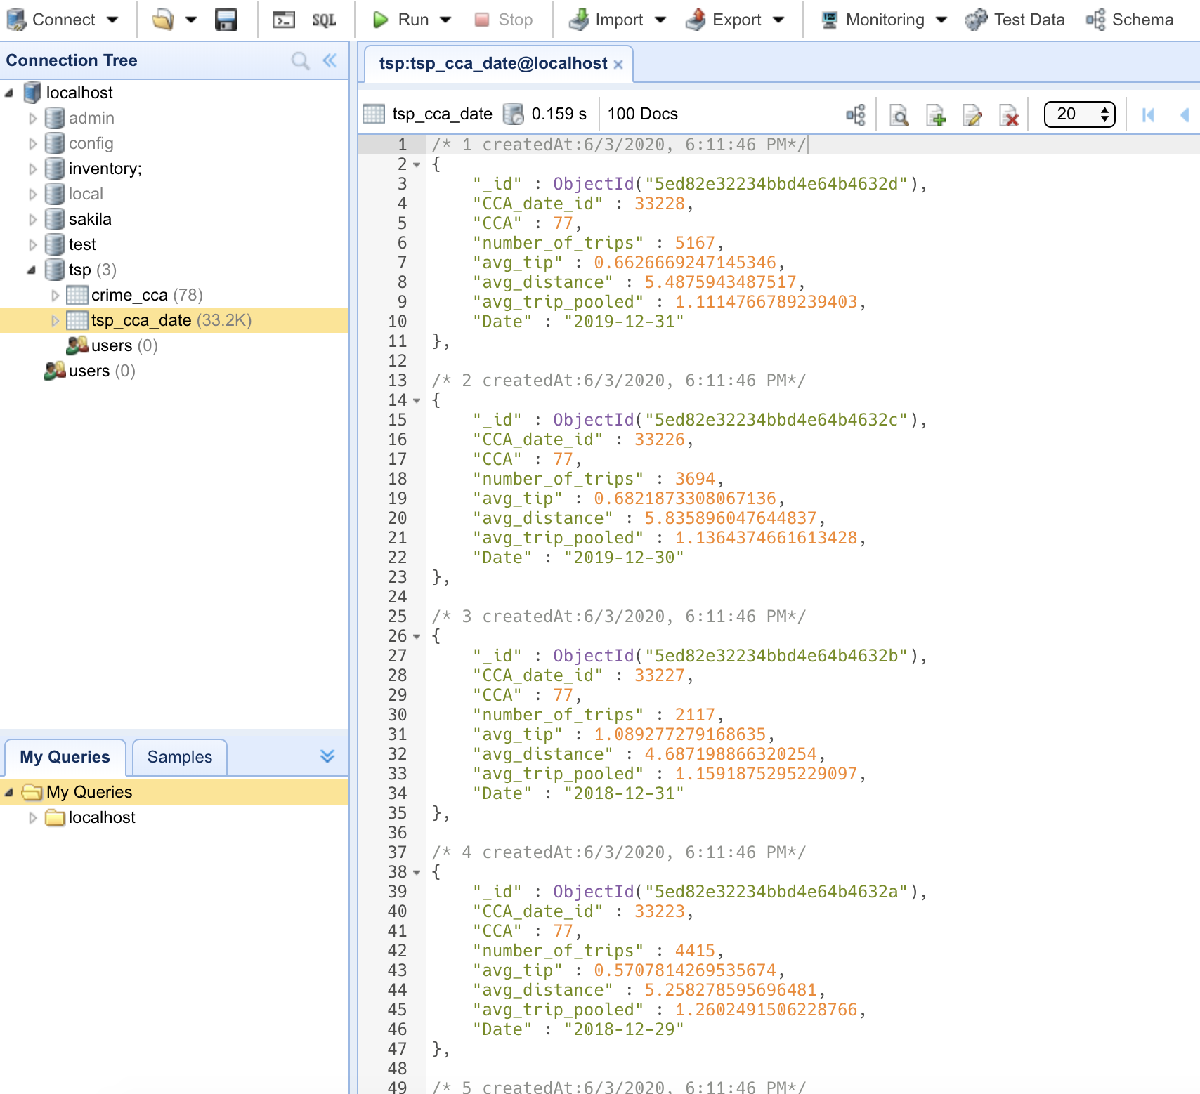

NoSQL Consideration
MongoDB
Can create document based OLTP database with each real-time trip as a transaction
[ JSON File ] Each object contains measures from fact table and sub- arrays with information from dimension tables
Neo4j
Can create graphic based OLTP with each real-time trip as a transaction
[ Graphic Nodes ] Each node contains information of a trip or a dimension
Advantages
Easily store new data (update quarterly)
Flexible Schema
Notes:
We upload a few of our datasets onto mongo db and neo4j, generated the json files and graphic nodes.

Slide 14
Completeness: Missing values in weather dataset treated as zero
Validity: Data is transformed into fact and dimensions to meet our analytical need
Uniqueness: No duplicated data
Consistency: Data format is consistent throughout the database
Timeliness: Data represent reality in time as data consist all the entries over the period considered
Accuracy: Data is simply aggregated by summing and averaging over locations and dates, and this transformation can represent reality
Data Quality Dimension

Slide 15
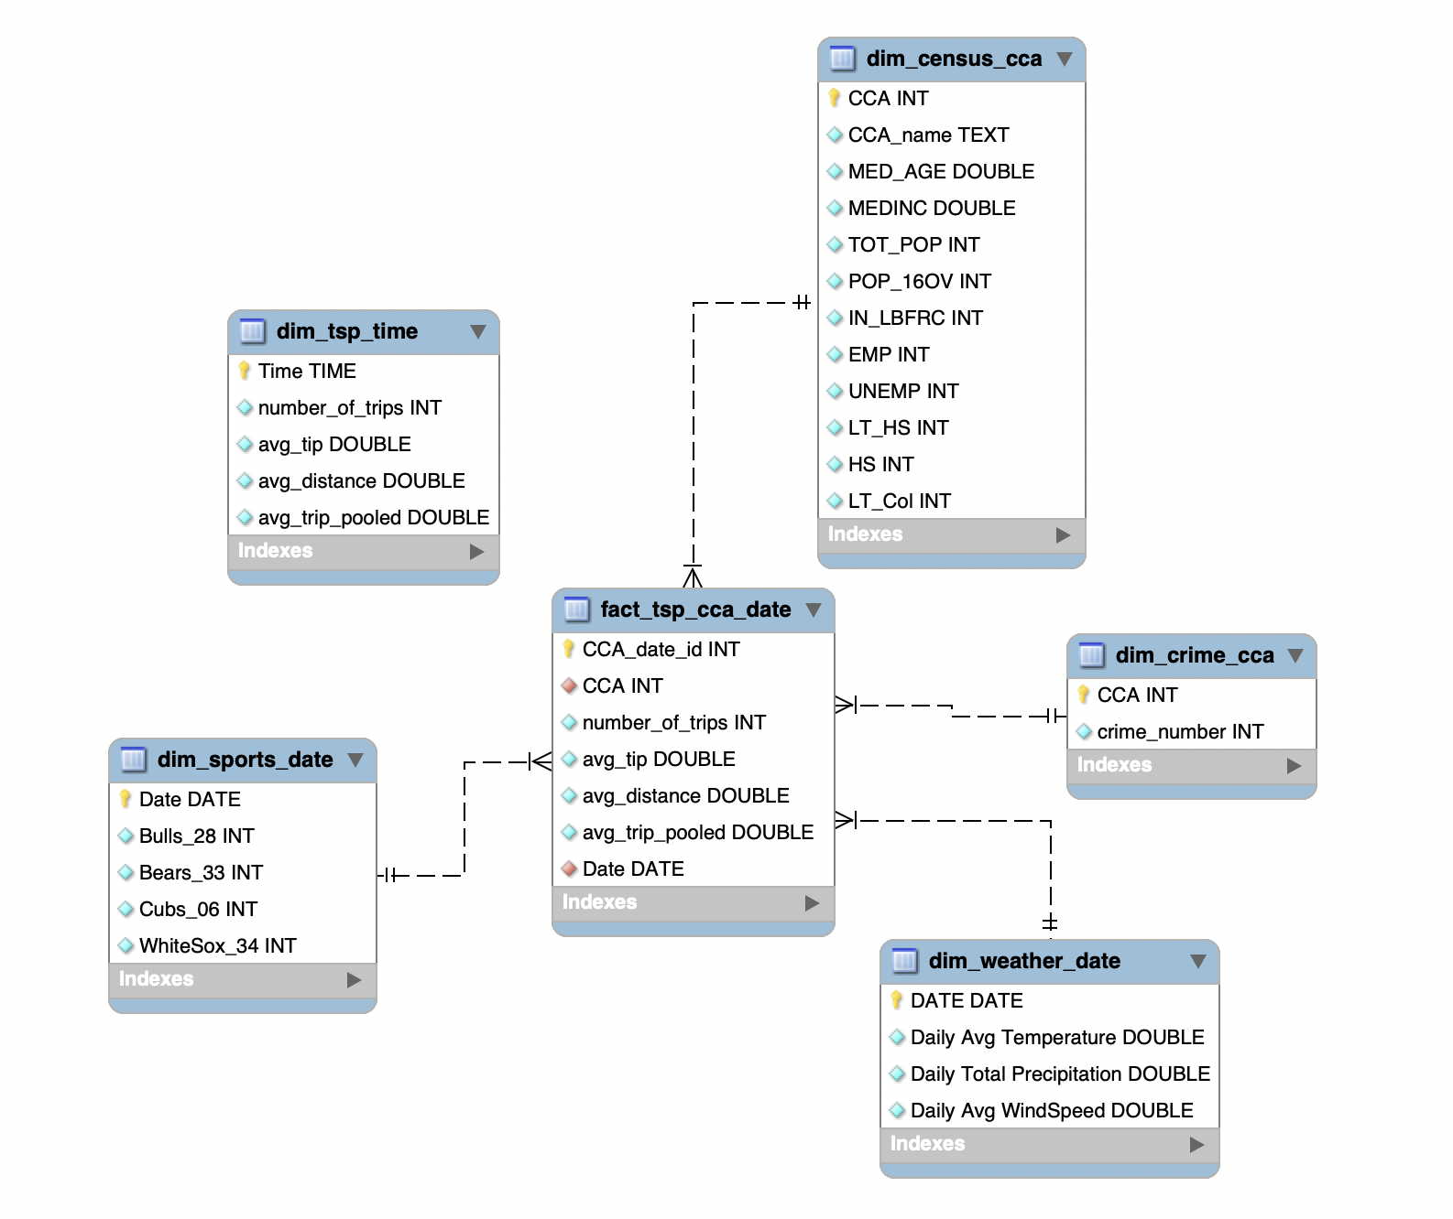
Enhanced Entity Relationship diagram
Notes: dim_tsp_time table is an independent table to analyze the average change of measures from hour to hour within a day.
Notes:
Our
Notes: dim_tsp_time table is an independent table to analyze the ridership within a day.

Slide 16
analytics & RESULTS

Slide 17
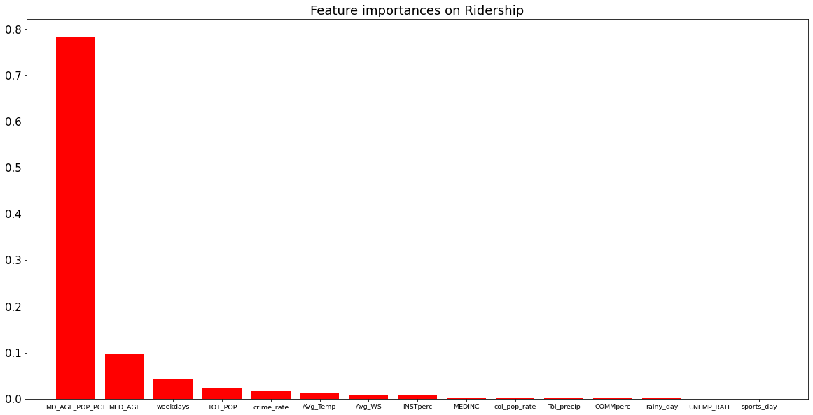
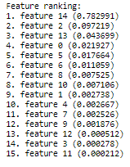
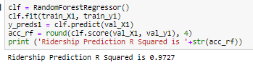
Random Forest Regressor
Important Features

Slide 18
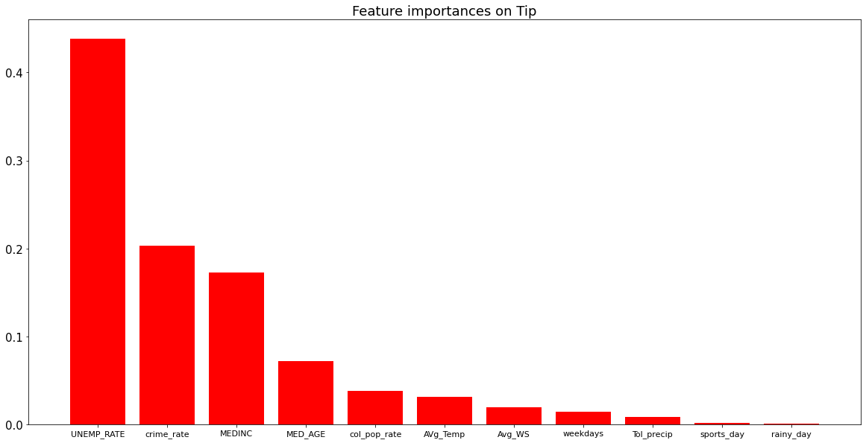
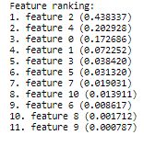
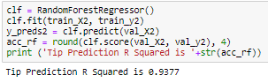
Random Forest Regressor
Important Features

Slide 19
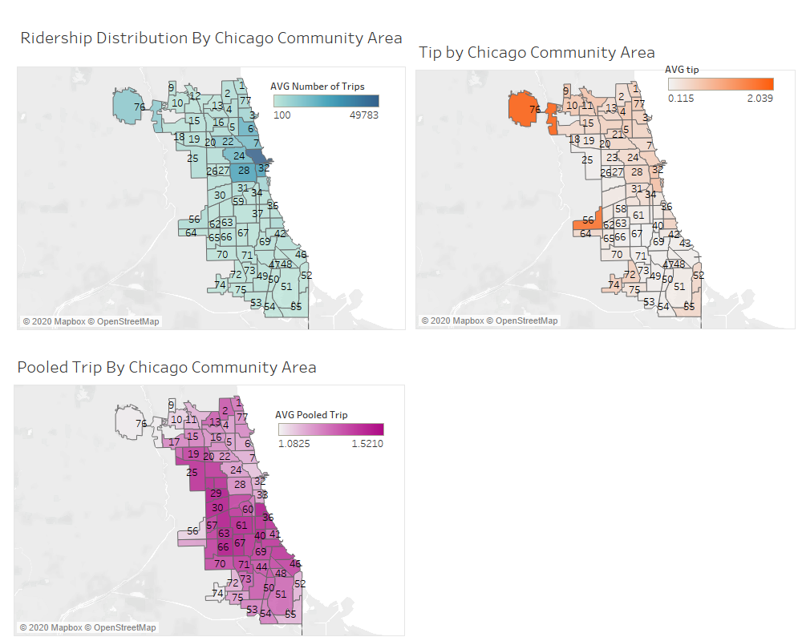
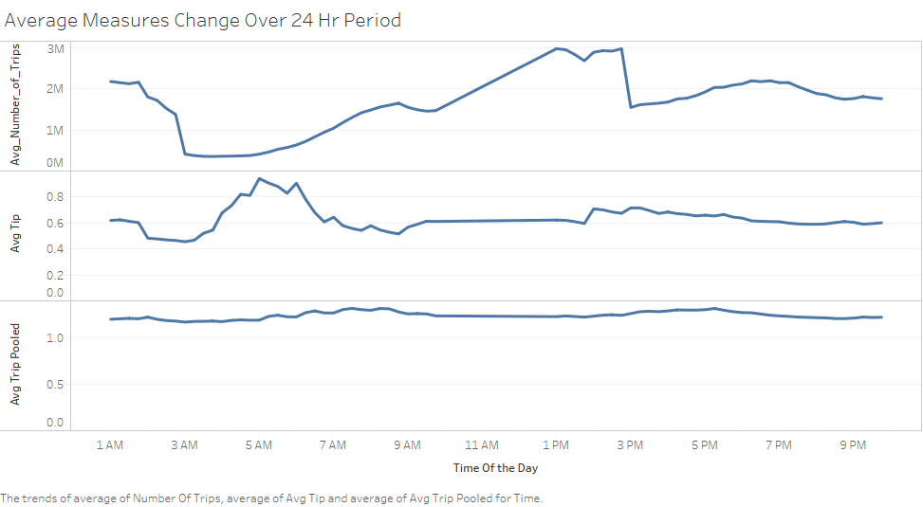
Notes:
Tip are higher in CCA where O’hare international airport and Midway airport are located
Neighborhoods with higher income tip better
Carpool are used more in west and south lower income neighborhoods of Chicago.

Slide 20
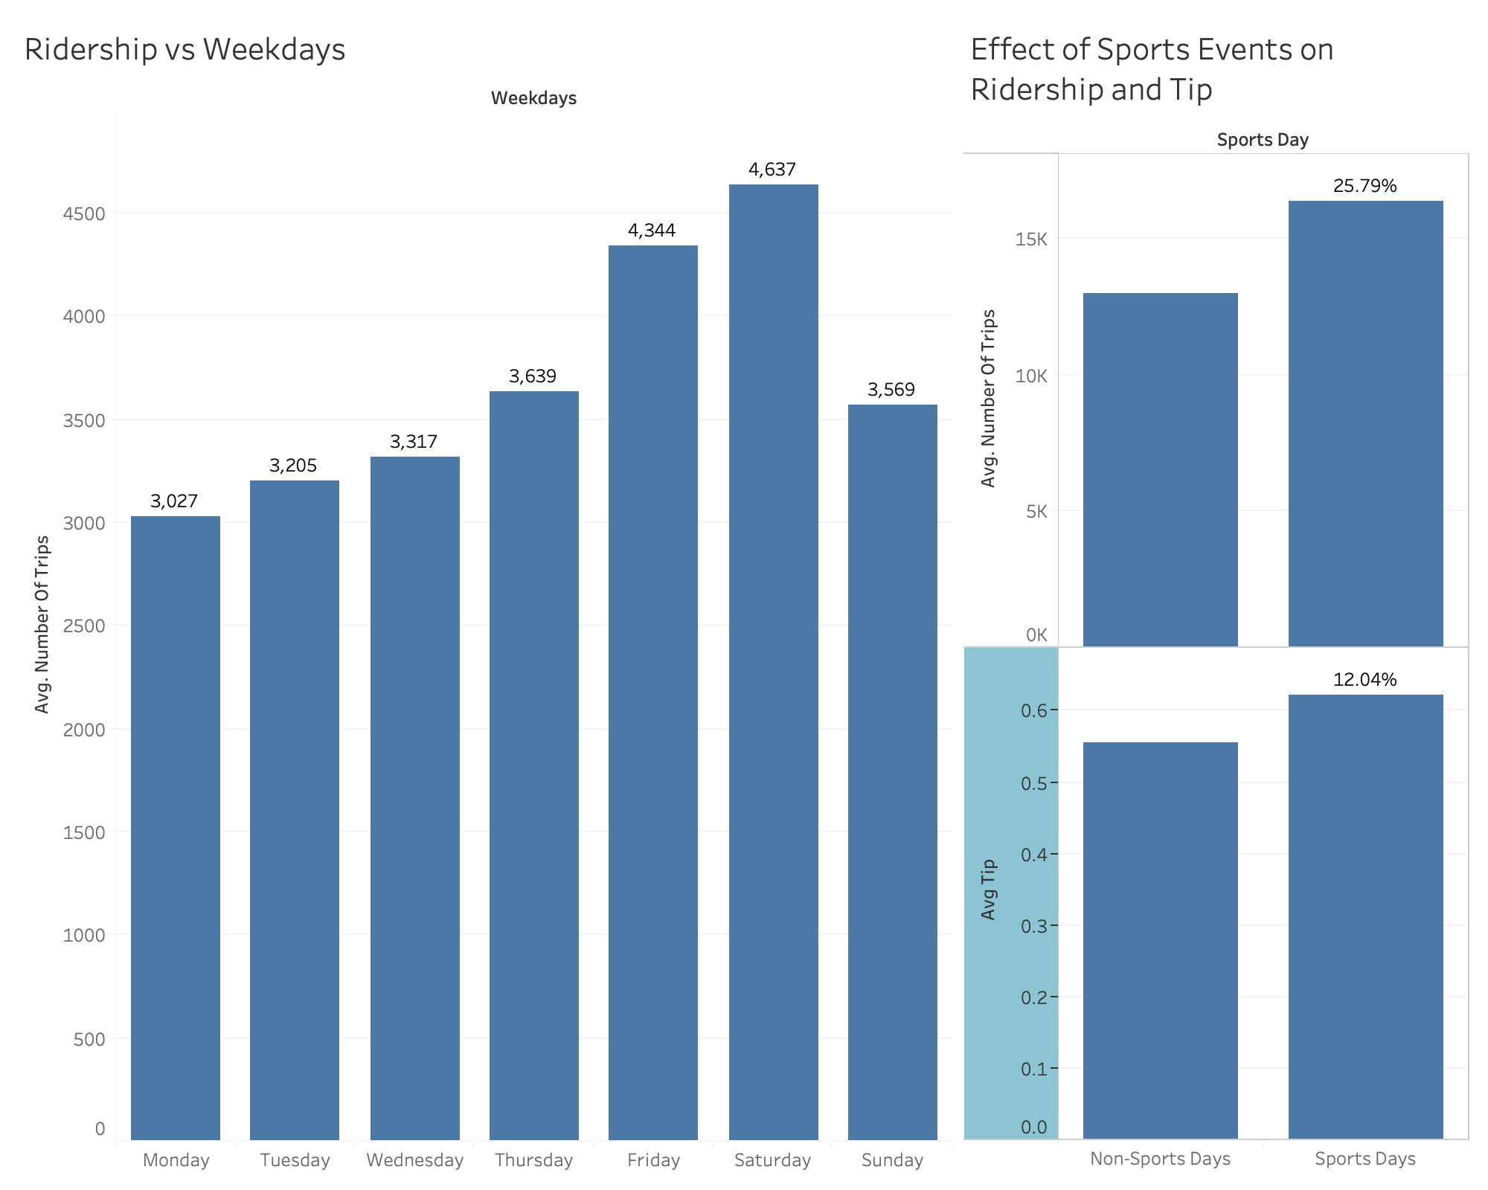

Slide 21
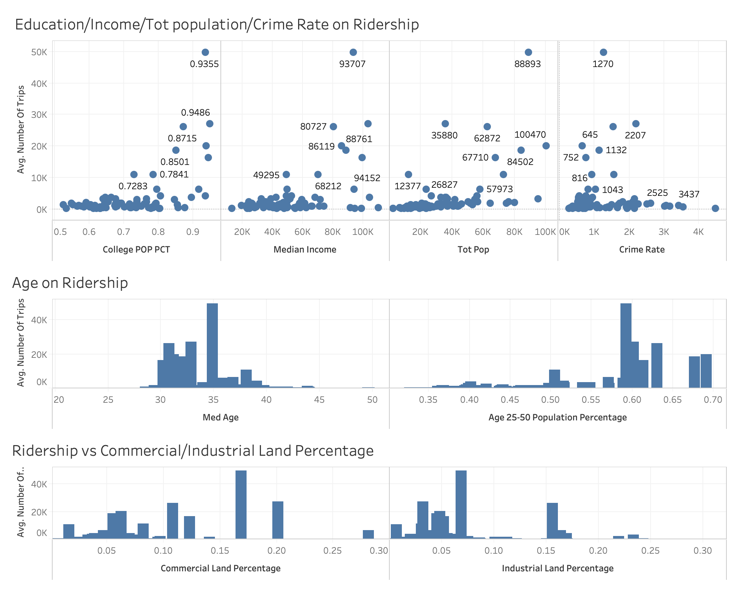

Slide 22
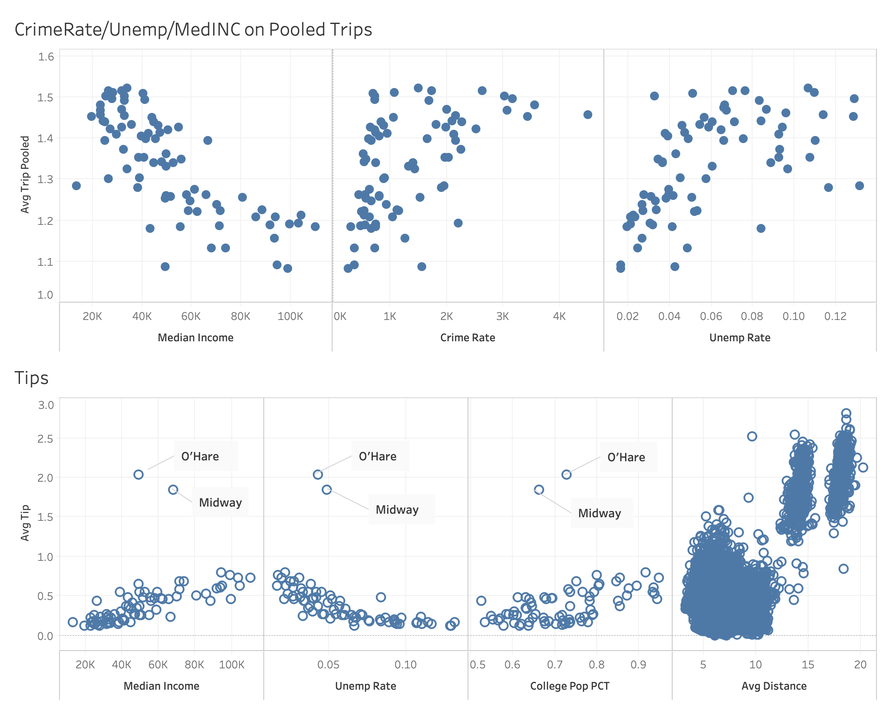

Slide 23
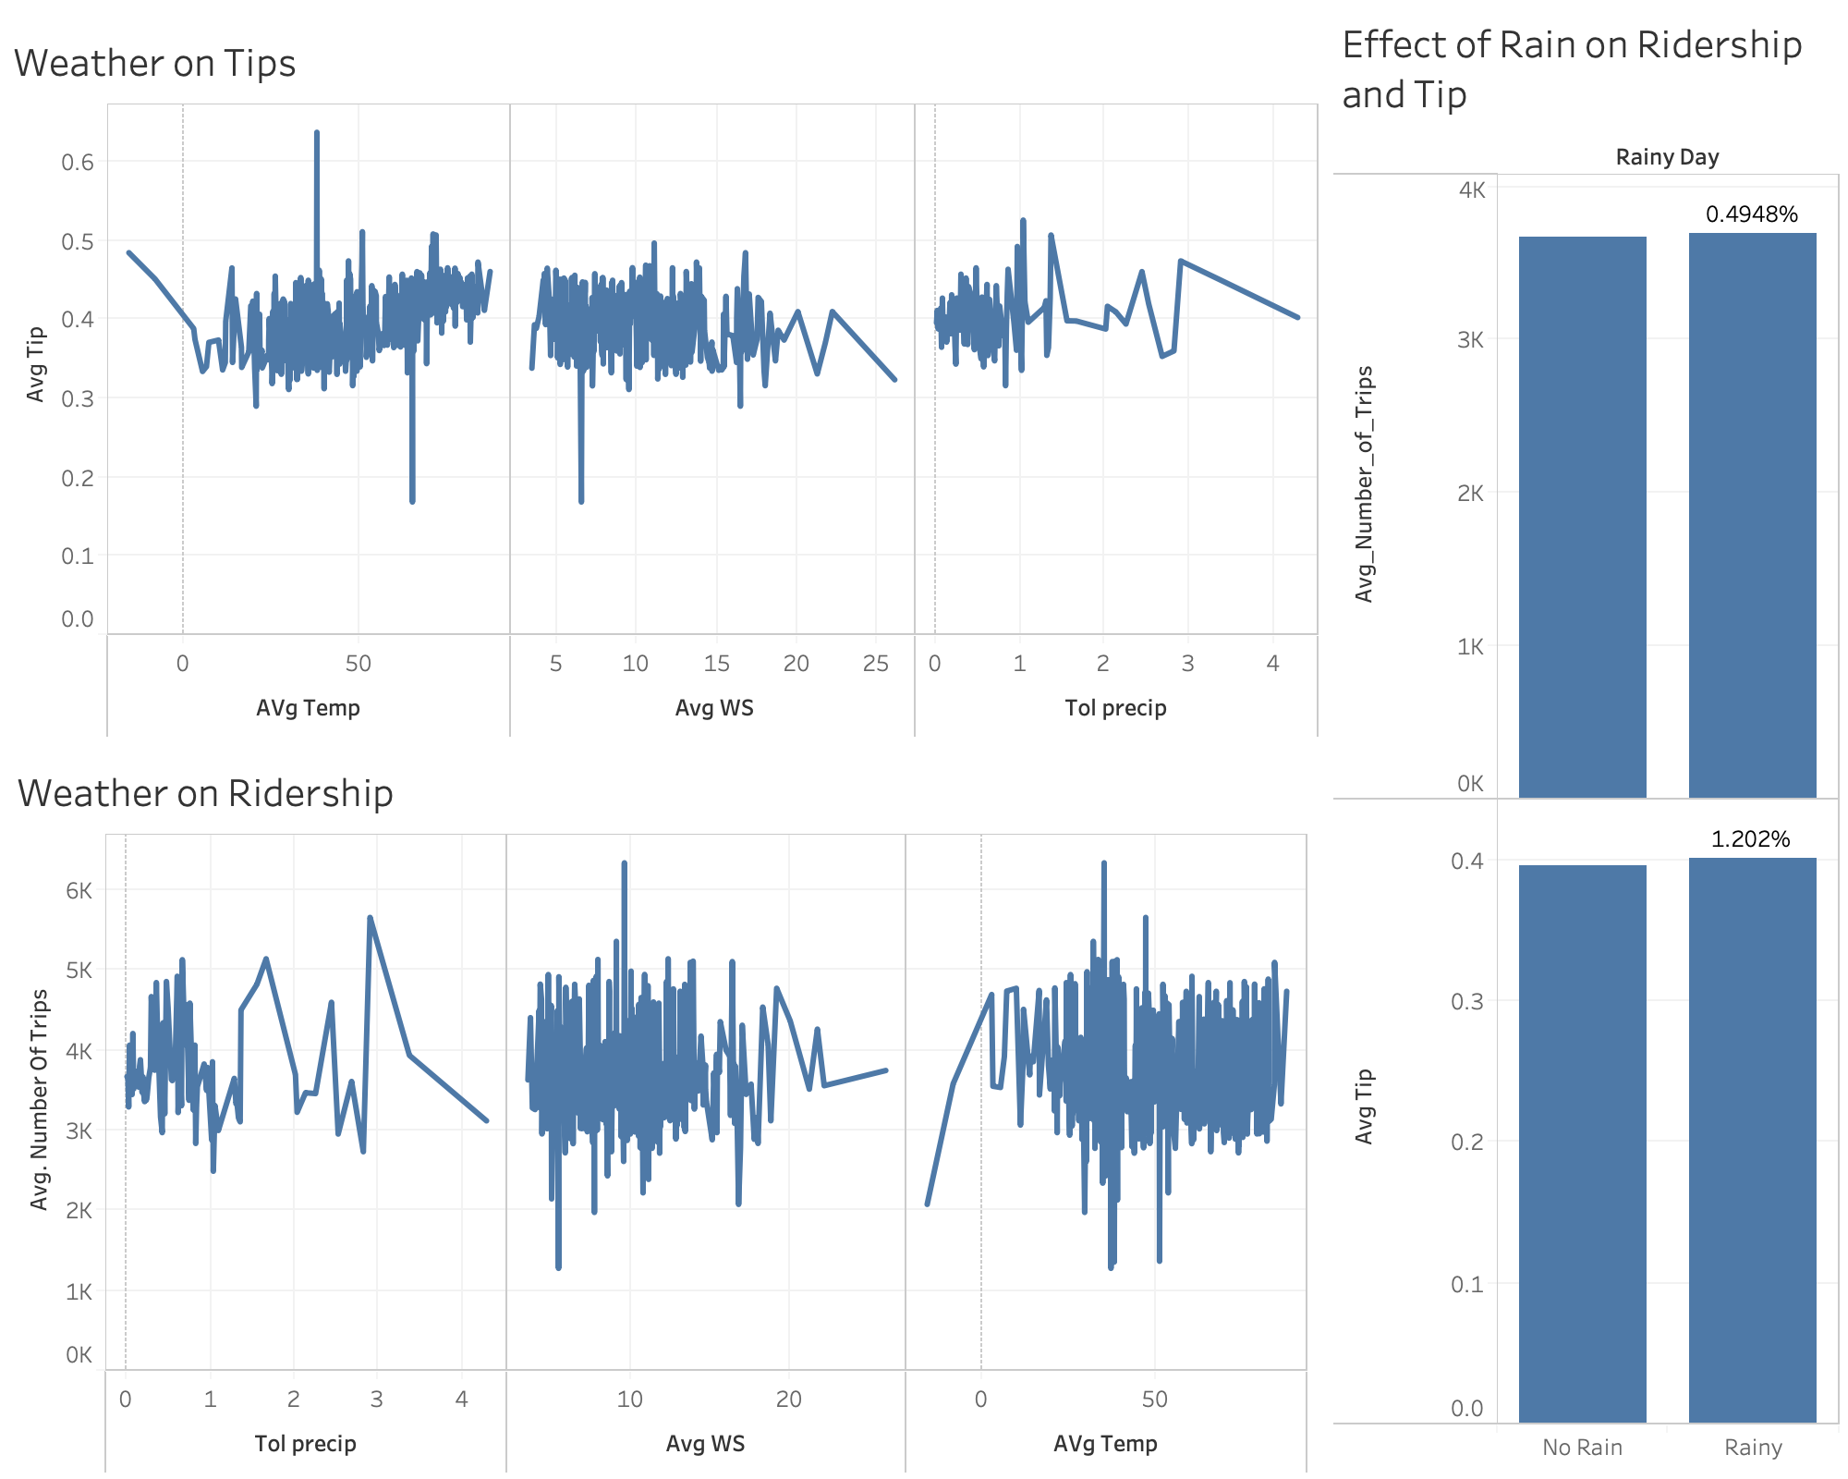

Slide 24
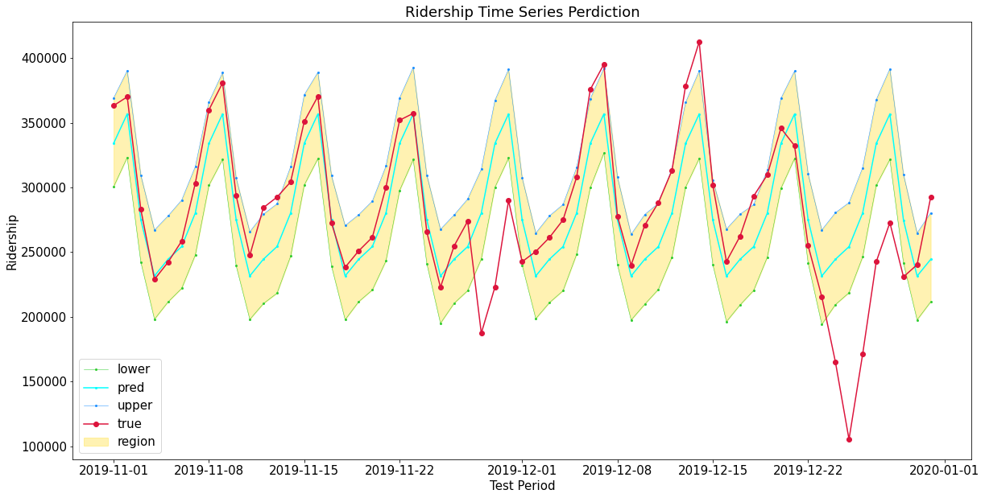
Time Series Forecast
(Facebook Prophet)

Slide 25
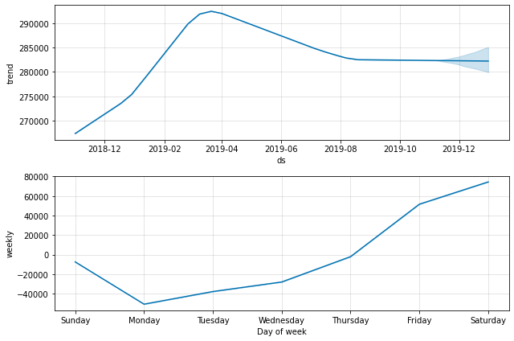
Time Series Forecast
(Facebook Prophet)
Facebook Prophet produces same weekly pattern as our analysis

Slide 26
Conclusion & RECOMMENDATIONS

Slide 27
Conclusion / Recommendation
Ridership and Tips are independent of weather.
Airport customers tend to tip exceptionally better and travel longer distances.
CCA with better economic and education statistics tend to utilize more services and tip better.
TNP companies should allocate more vehicles in the business and college districts.
Ridership increases towards weekend and peaks on Fridays and Saturdays.
Ridership also increases through morning and peaks in the mid-day.
Encourage drivers to participate more during weekends and mid-day by lowering commission fee.

Slide 28
Conclusion / Recommendation
Customers between age 25 and 40 are the biggest base for TNP.
Marketing Campaign should target on this age group
Increasing TNP awareness among other age groups.
On sports days, ridership increase about 25% in the home game CCAs.
Encourage drivers to move to sports home arena CCAs on sports days
Neighborhoods with higher crime rates have worse economic and educational status, people tend to do more pooled trips.
Increase wait time limit in high crime Neighborhoods for customer safety

Slide 29
Future work/LESSON LEARNED

Slide 30
Future Work/LESSON LEARNED
Ridership forecast can be more accurate with data from 2020 taking the consideration of Covid-19.
Ridership and Tips should be analyzed with more attributes, like public transportation distribution and major facilities’ location, etc.
Our initial intuition does not match the analysis result. Machine Learning and Statistical Analysis should be applied with more attributes to select a better set of predictors.
During discovery and data preparation phase, a closer analysis should be applied to determine whether there is enough information in the data to meet our analytical goals.

Slide 31
reference
Jonathan Levy. (2018). Transportation Network Providers – Trips [Data File]. Available from Chicago Data Portal: https://data.cityofchicago.org/Transportation/Transportation-Network-Providers-Trips/m6dm-c72p
Menne, Matthew J., Durre I., Korzeniewski B., McNeal S., Thomas K., Yin X., Anthony S., Ray R., Vose R., Gleason B., and Houston T. (2012). Global Historical Climatology Network - Daily (GHCN-Daily), Version 3. [indicate subset used]. NOAA National Climatic Data Center. doi:10.7289/V5D21VHZ [access date]. Available from National Centers for Environmental Information web site: https://www.ncdc.noaa.gov/cdo-web/datasets
City of Chicago. (2013). Boundaries - Community Areas (current). Available from Chicago Data Portal Web Site: https://data.cityofchicago.org/Facilities-Geographic-Boundaries/Boundaries-Community-Areas-current-/cauq-8yn6
Chicago Police Department. (2019). Crimes - 2001 to present [Data File]. Available from Chicago Data Portal Web Site: https://data.cityofchicago.org/Public-Safety/Crimes-2001-to-present/ijzp-q8t2
Chicago Metropolitan Agency for Planning. (2015). Community Data Snapshots Raw Data, June 2019 Release [Data File]. Available from CMAP Data Hub Web Site: https://datahub.cmap.illinois.gov/dataset/community-data-snapshots-raw-data
2018-19 Chicago Bulls Schedule. (n.d.). Retrieved from https://www.espn.com/nba/team/schedule/_/name/chi/season/2019/seasontype/1
Chicago Bears NFL - Bears News, Scores, Stats, Rumors & More. (n.d.). Retrieved from https://www.espn.com/nfl/team/_/name/chi/chicago-bears
Chicago Cubs Baseball - Cubs News, Scores, Stats, Rumors & More. (n.d.). Retrieved from https://www.espn.com/mlb/team/_/name/chc/chicago-cubs
Chicago White Sox Baseball - White Sox News, Scores, Stats, Rumors & More. (n.d.). Retrieved from https://www.espn.com/mlb/team/_/name/chw/chicago-white-sox

Slide 32
THANK YOU! Q/A

Slide 33
appendix

Slide 34
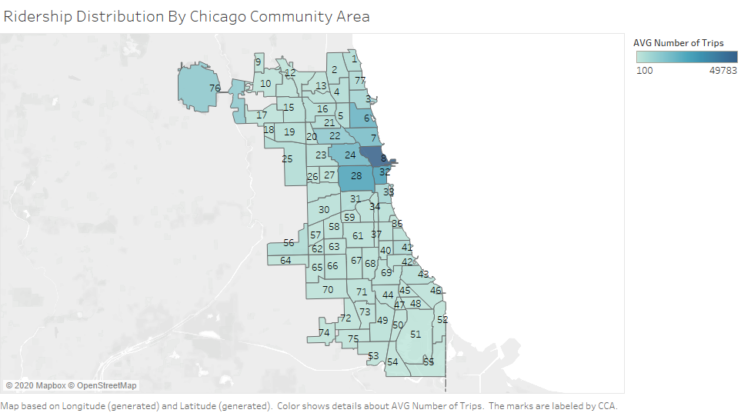
People in business districts and surrounding neighborhoods tend to utilize the service more.

Slide 35
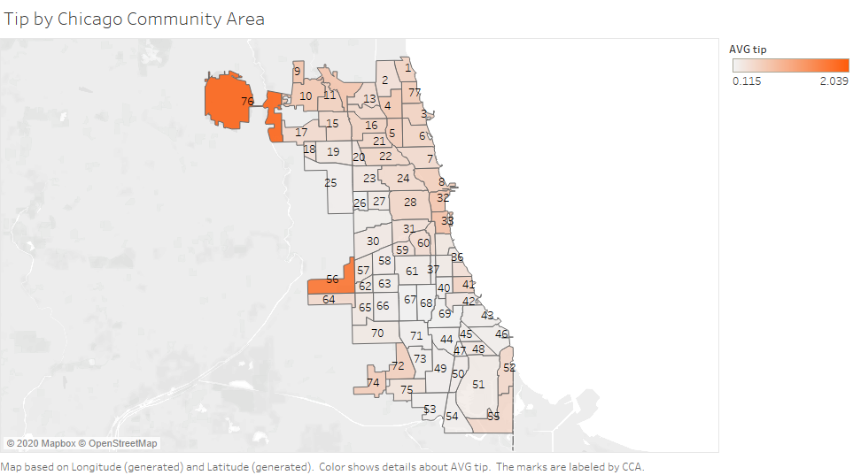
Tip are higher in CCA where O’hare international airport and Midway airport are located
Neighborhoods with higher income tip better

Slide 36
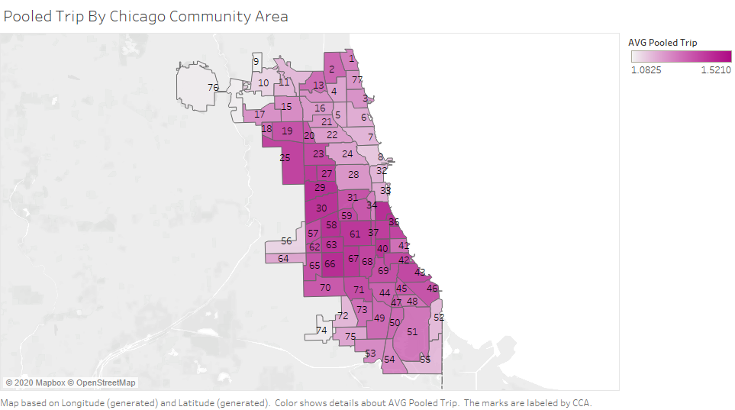
Carpool are used more in west and south lower income neighborhoods of Chicago.

Slide 37
Higher number of trips at daytime
Rapid decline from 2-3pm might due to rush hour or data gap
Higher tips from 5-7am, reason might be morning arrival or departure flight
No significant difference for carpool over 24hr period

Slide 38
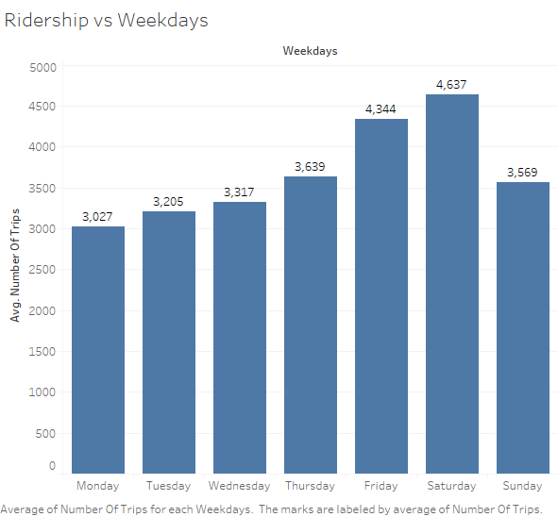
Friday and Saturday have the most ridership due to the coming of weekends.

Slide 39
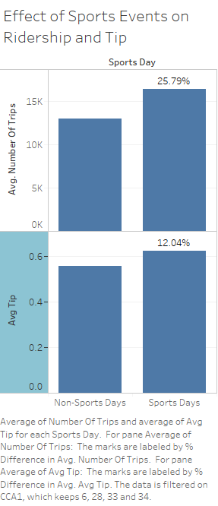
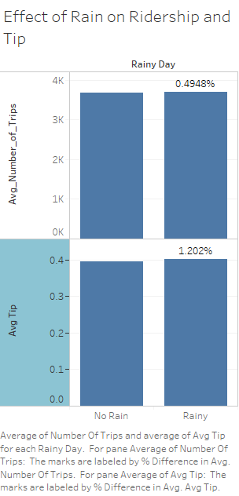
Higher Number of Trips and Tips during sports event days
No significant difference in Number of trips and Tips among rainy day

Slide 40
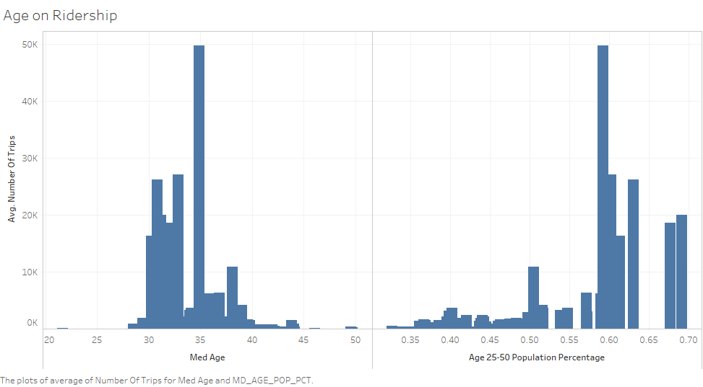
Most customers are at the age between 25 to 40

Slide 41
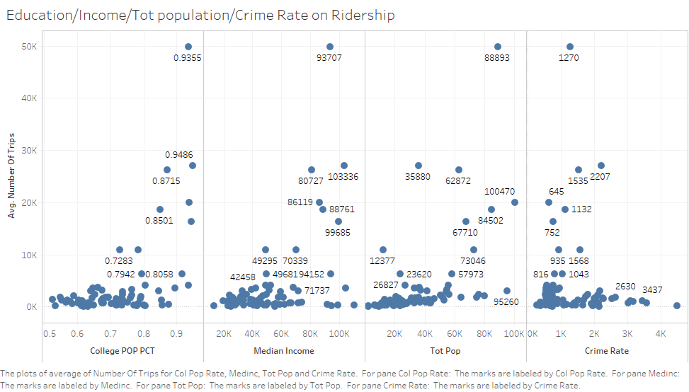
Higher Education -> More Trips
Higher Population -> More Trips
Higher Income -> More Trips
Higher Crime Rate -> Fewer Trips

Slide 42
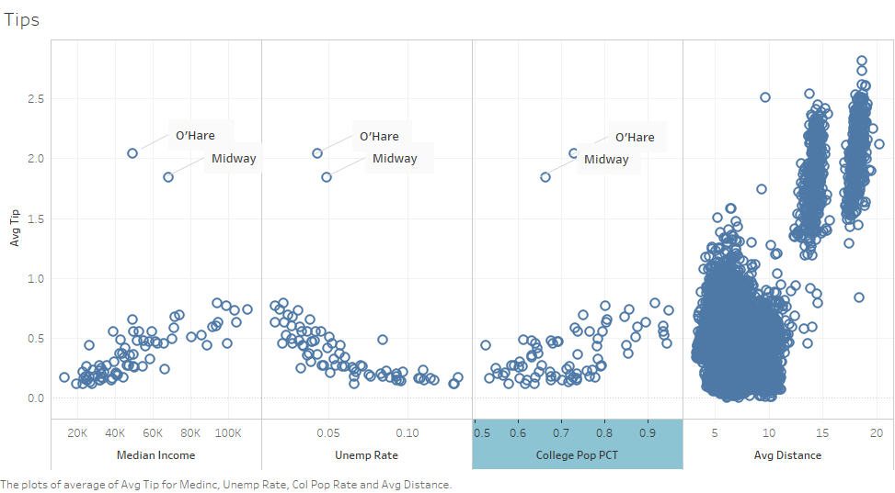
Higher Income -> Higher Tips
Higher Education -> Higher Tips
Higher unemployment rate -> Less Tips
Longer Distance -> Higher Tips
Explaining higher tips in O’Hare and Midway airport

Slide 43
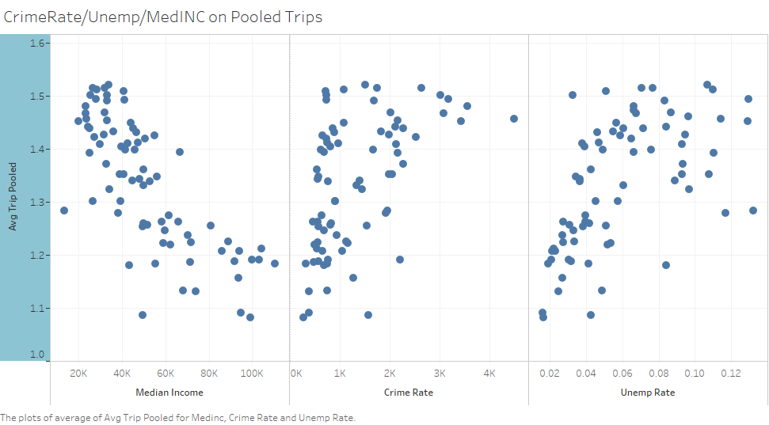
Lower Income -> More Carpool
High unemployment rate -> More Carpool
Higher Crime Rate -> More Carpool

Slide 44
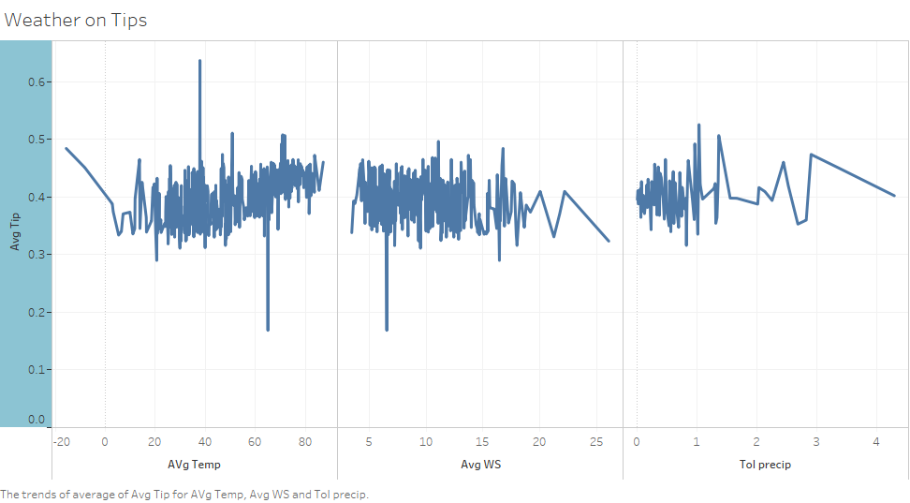
No significant difference among avg temperature, avg windspeed and total precipitation over tip.

Slide 45
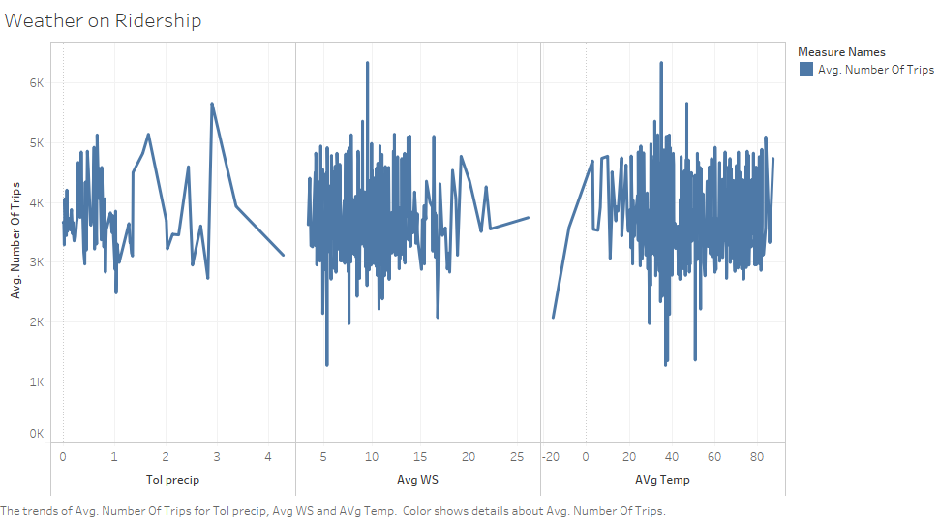
No significant difference among avg temperature, avg windspeed and total precipitation over number of trips.

